Slide 1


CLASSIFICATION USING K-MEANS CLUSTERING APPLIED TO HEART DISEASE PREDICTION
By Niladri Das
Under the supervision of Dr. Sanjoy Kumar Saha

Slide 2
INTRODUCTION
MACHINE LEARNING
CLASSIFICATION
CLUSTERING
EVALUATION MODELS FOR CLASSIFICATION
EVALUATION METRICS FOR CLASSIFICATION
FEATURE SELECTION METHODS
OVERSAMPLING METHODS
UNDERSAMPLING METHODS
FEATURE SCALING METHODS
PROPOSED WORK

Slide 3
INTRODUCTION
As per name this is a project on the subtopics of Machine Learning.
So, in this presentation first I will discuss about the Machine Learning and its subtopics like classification and clustering.
Actually, this is a classification problem solved by segmenting the dataset using clustering algorithms.
Then, I will discuss about the Evaluation models and the Evaluation metrics.
Next, I will decide which Evaluation model and Evaluation metrics best fit for my project work.
After that, I will discuss about some special techniques used to preprocess the dataset in this project.
Finally, I jump to the workflow of the project and discuss about its results.

Slide 4
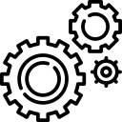
WORKFLOW OF THE PROJECT
DATASET
TWO LAYER CLUSTERING
MISSING VALUE FILLING
CLASSIFIER
OVERSAMPLING
DISEASED CLUSTERS
DISEASED CLUSTERS
FEATURE SELECTION
TRAIN TEST SPLIT
TRAIN DATASET
NORMALIZATION
AS IT IS
NON DISEASED CLUSTERS
UNDERSAMPLING
RESULT
NON DISEASED CLUSTERS
TEST DATASET

Slide 5
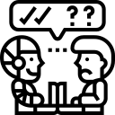
M A C H I N E L E A R N I N G
What is Machine Learning?
It might seem that this is a pretty new technology, but, in fact, it isn’t. The first ML-related work dates from 72 years ago, in 1950.
Significance of 1950 – Alan Turing creates the “Turing Test”. This test determined whether a computer had real intelligence or not.

Slide 6
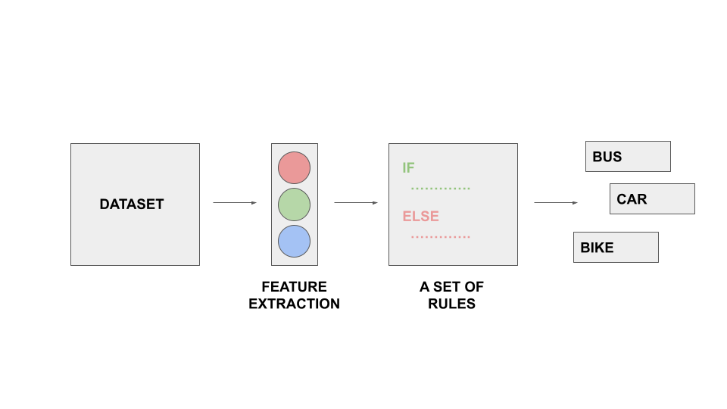
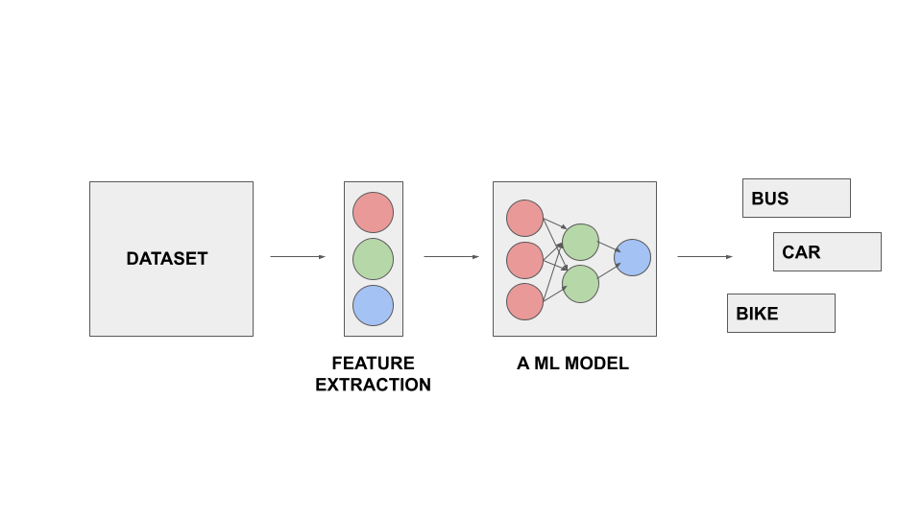
NORMAL PROGRAMING V/S ML
IN NORMAL PROGRAMMING
IN MACHINE LEARNING

Slide 7
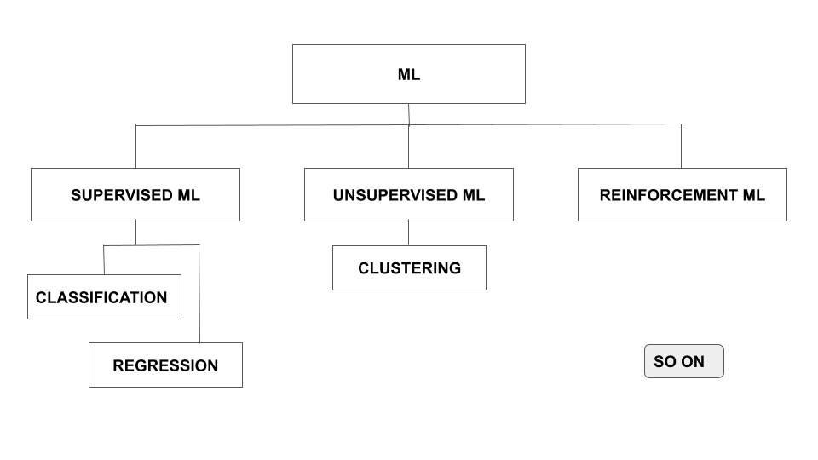
TYPES OF MACHINE LEARNING
Types of Machine Learning are bordered by different approaches of Machine Learning.

Slide 8
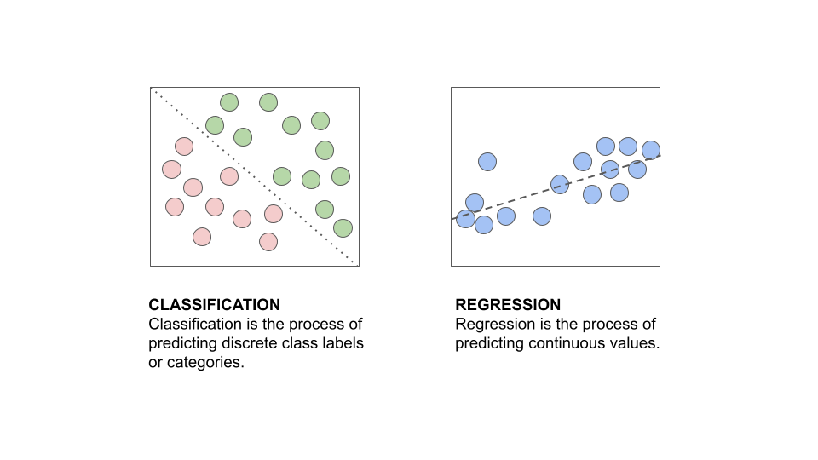
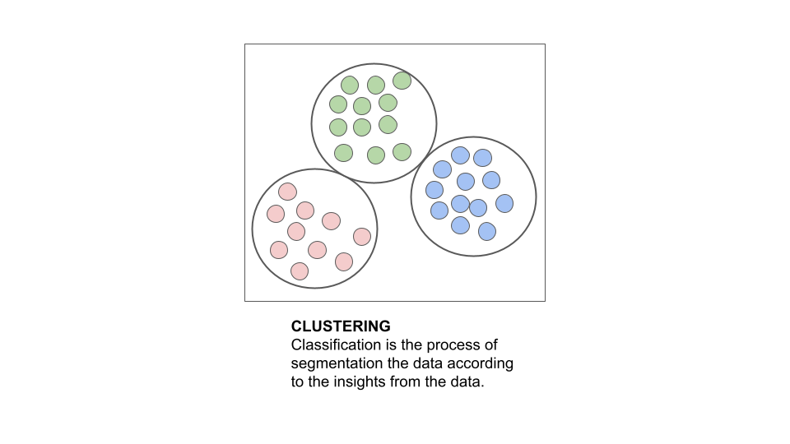
SUPERVISED ML V/S UNSUPERVISED ML
SUPERVISED ML
UNSUPERVISED ML

Slide 9
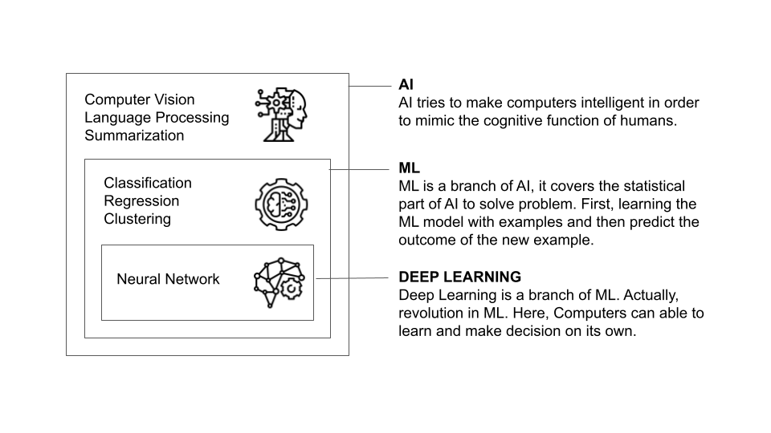
RELATIONSHIP OF ML WITH AI AND DEEP LEARNING
Machine Learning is a milestone to reach artificial intelligence and deep learning.
END OF MACHINE LEARNING

Slide 10
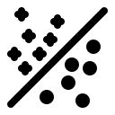
C L A S S I F I C A T I O N
Classification is a special type of supervised Machine Learning approach, which is used to categorize some unknown items into a discrete set of categories (i.e., categorical values).
Classification first attempts to learn the relationship between a set of feature variables and a target variable of interest and then determines the class label for an unlabeled test case.
Suppose we have a patient dataset.
In the patient dataset, there are seven independent variables (i.e., features) sex, age, education, and so on and one dependent variable (i.e., target) TenYearCHD (Ten Year Chance of Heart Disease).
i | sex | age | education | cigsPerDay | totChol | BMI | heartRate | TenYearCHD
0 | male | 39 | 4.0 | 0.0 | 195.0 | 26.97 | 80.0 | no
1 | female | 46 | 2.0 | 0.0 | 250.0 | 28.73 | 95.0 | no
2 | male | 48 | 1.0 | 20.0 | 245.0 | 25.34 | 75.0 | no
3 | male | 61 | 3.0 | 30.0 | 225.0 | 28.58 | 65.0 | yes
4 | male | 46 | 3.0 | 23.0 | 285.0 | 23.1 | 85.0 | no
5 | female | 40 | 1.0 | 13.0 | 300.0 | 30.0 | 95.0 | ?

Slide 11
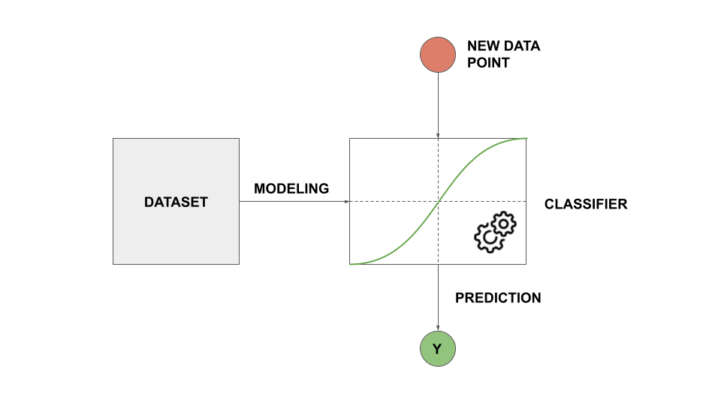
CLASSIFICATION MODEL
Now, we need to create a classification model which learns the relationship between the set of features and the target variable.

Slide 12
i | sex | age | education | cigsPerDay | totChol | BMI | heartRate | TenYearCHD
0 | female | 40 | 1.0 | 13.0 | 300.0 | 30.0 | 95.0 | yes
Then, the model will give us the prediction of the possibility of heart disease in the next ten years for new patients with the same feature set.
NOTE: The above example is an example of binary classification. Similarly, we can create models for multiclass classification.

Slide 13
VARIOUS CLASSIFICATION ALGORITHMS
There are many classification algorithms for building both binary and multiclass classifiers or classification models.
Some of those are,
K Nearest Neighbors (KNN)
Decision Tree (ID3, C4.5, C5.0)
Logistic Regression (LR)
Support Vector Machine (SVM)
Native Bayes
Neural Network
, and so on.

Slide 14
APPLICATIONS OF CLASSIFICATION
There are many uses of classifications in the real world.
We can use classification to categorize a customer. Like, banks need to categorize customers for loan approval, telecommunication service providers need to know about whether a customer switches to another provider or not, advertisement companies need to know whether a customer responds or not, and so on.
There is a wide range of use of classification in the medical sector. Like, whether a patient is affected by a disease or not. Also, we can use classification to find perfect drugs for a patient.
END OF CLASSIFICATION

Slide 15
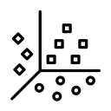
C L U S T E R I N G
Clustering is a special type of unsupervised Machine Learning approach, it is used to find clusters/segments in a dataset by reading the pattern in between the features set of the dataset.
In simple words, Clustering is used to create mutually exclusive groups in a dataset in an unsupervised way, based on similarity of the features set of the dataset.
Suppose we have a patient dataset.
We have to find which patient is in which category according to their age and weight.
i | sex | age | education | totChol | BMI | thyroid
0 | male | 39 | 4.0 | 195.0 | 26.97 | no
1 | female | 46 | 2.0 | 250.0 | 28.73 | no
2 | male | 48 | 1.0 | 245.0 | 25.34 | no
3 | male | 61 | 3.0 | 225.0 | 28.58 | yes
4 | male | 46 | 3.0 | 285.0 | 23.1 | no
5 | female | 40 | 1.0 | 300.0 | 25.0 | yes

Slide 16
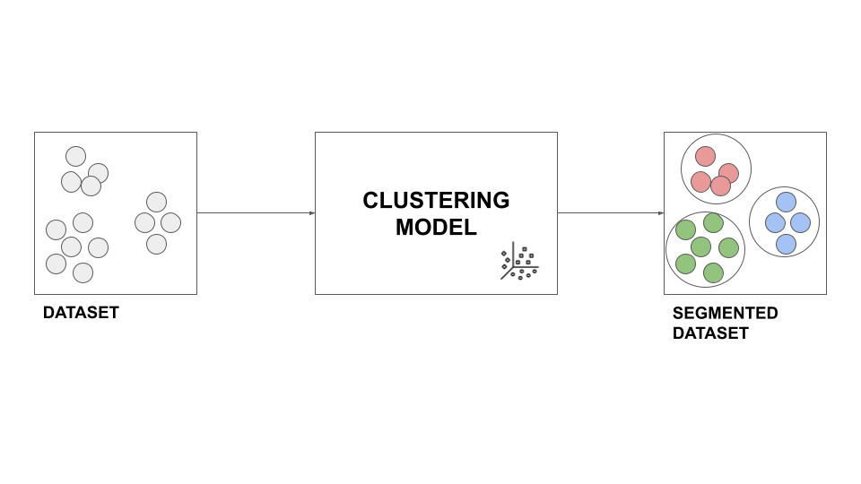
CLUSTERING MODEL
Now, we need to create a clustering model which learns the relationship between the set of features and segment the dataset.

Slide 17
i | sex | age | education | totChol | BMI | thyroid | typeOfPatient
0 | male | 39 | 4.0 | 195.0 | 26.97 | no | Young and overweight
1 | female | 46 | 2.0 | 250.0 | 28.73 | no | Middle aged and overweight
2 | male | 48 | 1.0 | 245.0 | 25.34 | no | Middle aged and overweight
3 | male | 61 | 3.0 | 225.0 | 28.58 | yes | Old and overweight
4 | male | 46 | 3.0 | 285.0 | 23.1 | no | Middle aged and middleweight
5 | female | 40 | 1.0 | 300.0 | 25.0 | yes | Middle aged and overweight
The segmented data given by the model.
NOTE: The above example is an example of a clustering model on two-dimensional space. Similarly, we can create clustering models on multi-dimensional space.

Slide 18
VARIOUS CLUSTERING ALGORITHMS
There are many clustering algorithms for building clustering models. According to the methodology of the algorithms, clustering algorithms are divided into three types.
Those are,
Partition Based Clustering
These algorithms are relatively efficient and are used for medium and large sized datasets.
Main drawback of these algorithms is finding the best partitions.
E.g., K-Means, K-Median, Fuzzy C-Means.
Hierarchical Clustering
The main methodology of these types of algorithms is producing trees of Clusters.
These algorithms are very intuitive and are generally good for use with small datasets.
E.g., Agglomerative ( down-up ), Divisive Algorithms ( up-down ).
Density Based Clustering
Produces arbitrary shaped clusters.
These are especially good algorithms when dealing with special clusters or when there is noise in the dataset.
E.g., DBSCAN (Density Based Spatial Clustering Algorithm).
All of the above clustering algorithms are used for different purposes of real world work.

Slide 19
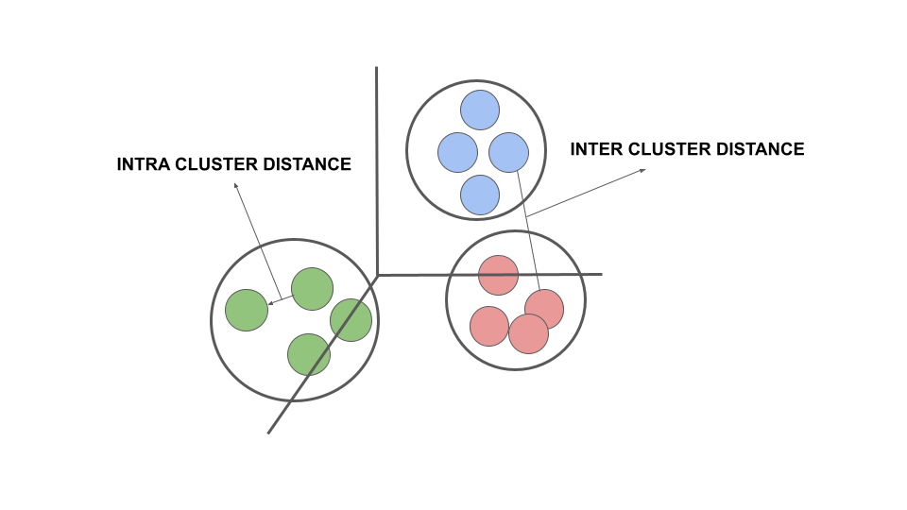
K MEANS CLUSTERING ALGORITHM
Main Objectives of K-Means are,
It divides the dataset into K non-overlapping clusters without any cluster internal structure or labels.
K-means is used to form clusters in such a way that similar samples go into a cluster and dissimilar samples fall into different clusters.
K-means tries to minimize the intra cluster distances and maximize the inter cluster distances.
So, the distance of the sample data points from each other is used to find the shape of the cluster.

Slide 20
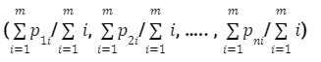


DISTANCE METRIC
CENTROID
ACCURACY
Here, I use Euclidean distance as distance metric to calculate the distance from one data point to another.
The formula of the Euclidean distance in n dimensional space from one data point to another data point is,
Where,
p ≡ (p1, p2, …., pn)
q ≡ (q1, q2, …., qn)
Each cluster must have a centroid.
It is hypothetically the center point of the cluster. In K-Means the centroid of a cluster is defined as,
Where,
n = number of features (i.e., number of dimensions of the vector)
m = number of data points (i.e., number of vectors)
To know how accurate our clustering model, there is a metric to find error in our model.
Which is known as Sum of the Squared Difference(SSE) between each point and its centroid.
Where,
xi indicates to each data points
k indicates to number of clusters
n indicates to number of data points
cj indicates to cluster centroid of j th cluster

Slide 21
STEPS OF K MEANS CLUSTERING ALGORITHM
Initialize K value and randomly/manually place K centroids, one for each cluster.
Calculate distance of each data point from each centroid.
Assign each data point to its closest centroid and create a cluster.
Calculate the position of the new K centroids.
Repeat the steps from II to IV, until the centroids no longer move. Please note that, whenever a centroid moves, the distance from the recent old centroid to the recent new centroid is measured.
Yes, K-means is an iterative algorithm and we have to repeat steps II to IV until the algorithm converges.

Slide 22
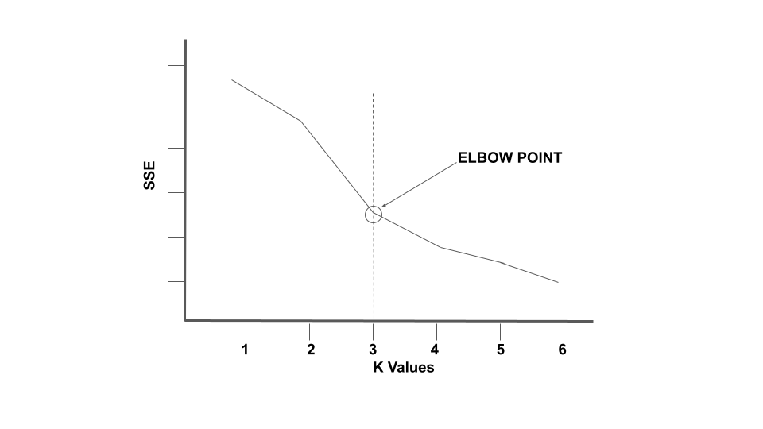
ELBOW METHOD
In the K-Means algorithm K actually indicates the number of clusters.
One of the best methods and commonly used methods for finding K value is to run a clustering model across the different values of k and looking at SSE for minimum error for clustering model.
Then, looking at the change of SSE with respect to K values.
But, the problem is the increasing K value will always reduce the error i.e., SSE.
So, choose the elbow point where the rate of decrease sharply shifts.
It is the right K value for our clustering model.
This method is known as Elbow Method.

Slide 23
OBSERVATIONS ABOUT THE K MEANS CLUSTERING ALGORITHM
Some observations about the K-Means algorithm :
It is a heuristic algorithm, there is no guarantee that it will converge to the global optimum and the result may depend on the initial clusters. The algorithm is guaranteed to converge to a local optimum and the result is not necessarily the best possible outcome.
K-means is an iterative algorithm.
It is relatively efficient for medium and large size datasets.
It produces sphere-like clusters because the clusters are shaped around the centroids.
Its drawback is that we should pre specify the number of clusters, and this is not an easy task.
— THIS CONCLUDES THE K MEANS CLUSTERING ALGORITHM.

Slide 24
APPLICATIONS OF CLUSTERING
There are many uses of Clustering in the real world. One of the main uses of clustering is segmentation of data. In marketing we can identify buying patterns of customers, recommending products to the new customers, etc. In banking or insurance sector fraud detection in credit card use, identifying types of customers (loyal/churned), so on. In the medical sector, characterizing patient behaviors, steps of a disease, etc. And many more.
END OF CLUSTERING

Slide 25
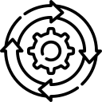
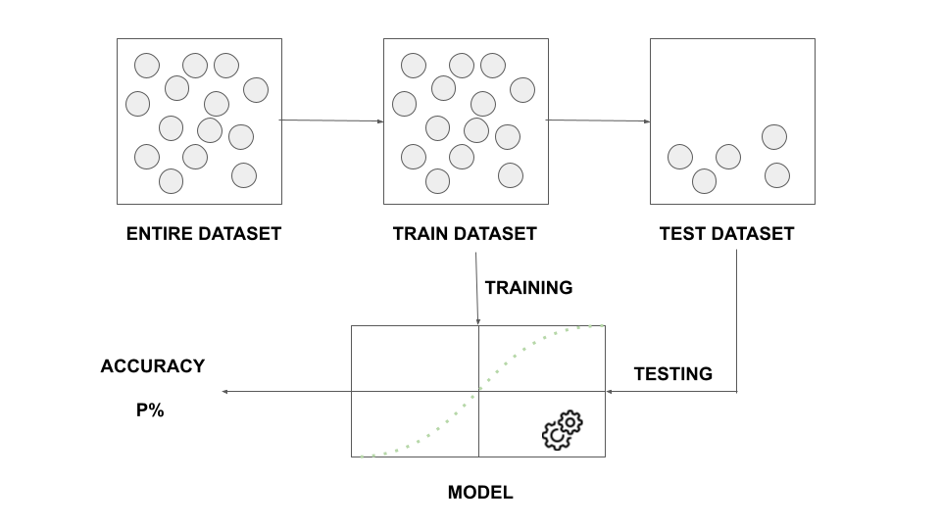
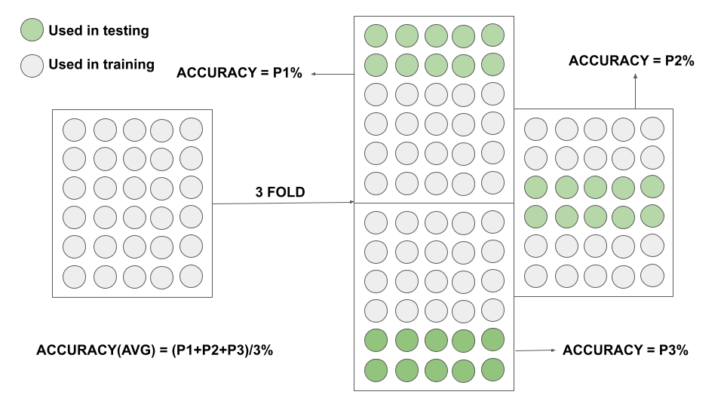
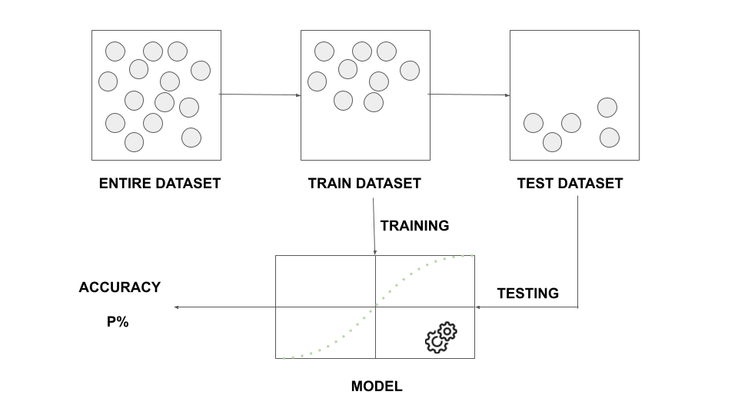
E V A L U A T I O N M O D E L S FOR CLASSIFICATION
There are few model evaluation techniques for classification used for different purposes.
Those are,
Train and Test on the same dataset
Train Test Split
K-Fold Cross Validation, and so on.

Slide 26
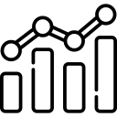
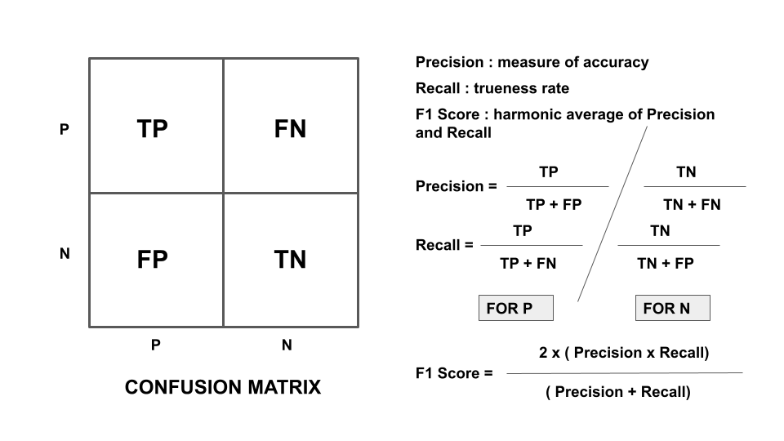
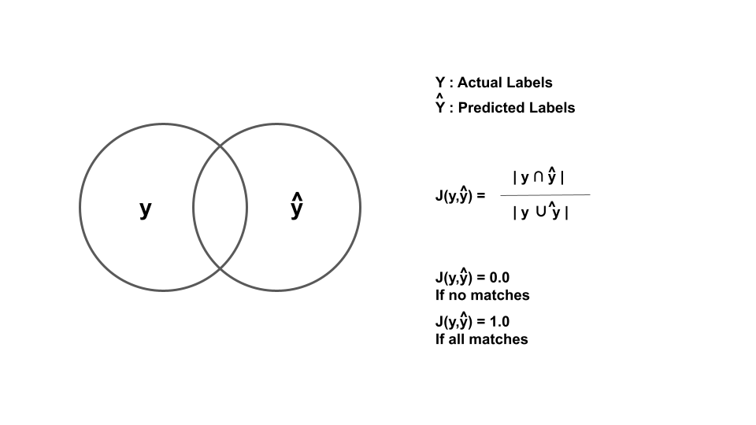
E V A L U A T I O N M E T R I C S FOR CLASSIFICATION
There are different model evaluation metrics for classification. Some of them are,
Jaccard Index
F1 Score
Log Loss, and so on.

Slide 27
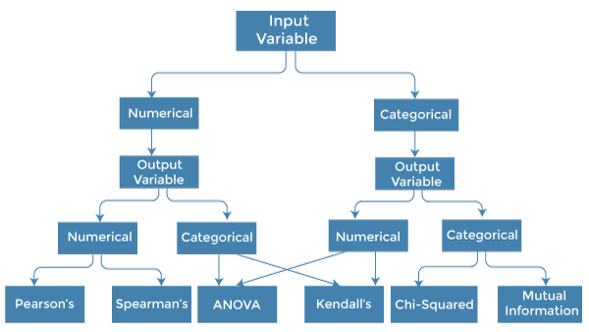
F E A T U R E S E L E C T I O N M E T H O D S
There are many feature selection methods according to the respective type of input variables and output variables. Some of those are,
PCA (Principle Component Analysis)
Chi Squared Test
ANOVA Test, and so on.

Slide 28
O V E R S A M P L I N G M E T H O D S
There are many oversampling methods for balancing the imbalanced dataset.
Some oversampling methods are:
ADASYN (Perform over-sampling using Adaptive Synthetic Sampling Approach for Imbalanced Learning.)
Random Oversampling (Object to over-sample the minority class(es) by picking samples at random with replacement.)
SMOTE (This object is an implementation of SMOTE - Synthetic Minority Over-sampling Technique), and so on.
SMOTE
Method that over samples the minority class by creating a new data point of minority samples.
There are some variants of SMOTE : the variants Borderline SMOTE 1, 2 and SVM-SMOTE.
Minority Class
Majority Class
x14
x11
diff
r1
x1
gap
x12
x13
r1=x1+gap*diff
Synthesized Data

Slide 29
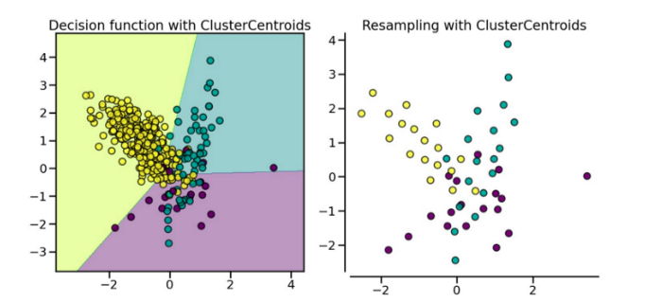
U N D E R S A M P L I N G M E T H O D S
There are many undersampling methods for balancing the imbalanced dataset.
Undersampling methods are actually divided into two types:
Prototype Generation
a. Cluster Centroids
Prototype Selection
Cluster Centroids
Method that under samples the majority class by replacing a cluster of majority samples by the cluster centroid of a KMeans algorithm. This algorithm keeps N majority samples by fitting the KMeans algorithm with N cluster to the majority class and using the coordinates of the N cluster centroids as the new majority samples.

Slide 30
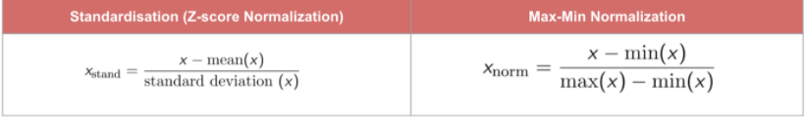
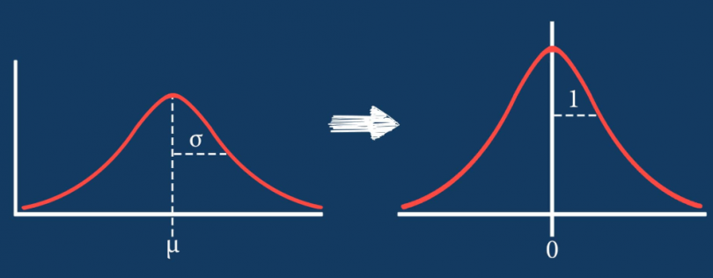
F E A T U R E S C A L I N G M E T H O D S
The two main feature scaling methods are,
Standardization
Normalization

Slide 31
PROPOSED WORK

Slide 32



What is the Problem?
DISEASED
OR
NON DISEASED
DATASET
CLASSIFIER USING CLUSTERING

Slide 33
NAME OF THE FEATURE | NON-NULL COUNT | DATA TYPE | VALUE TYPE (1 => TRUE, 0 => FALSE)
sex | 4238 | INT64 | CATEGORICAL (0/1)
age | 4238 | INT64 | NUMERICAL
education | 4133 | FLOAT64 | CATEGORICAL (1.0/2.0/3.0/4.0)
currentSmoker | 4238 | INT64 | CATEGORICAL (0/1)
cigsPerDay | 4209 | FLOAT64 | NUMERICAL
BPMeds | 4185 | FLOAT64 | CATEGORICAL (0.0/1.0)
prevalentStoke | 4238 | INT64 | CATEGORICAL (0/1)
prevalentHyp | 4238 | INT64 | CATEGORICAL (0/1)
diabetes | 4238 | INT64 | CATEGORICAL (0/1)
totChol | 4188 | FLOAT64 | NUMERICAL
sysBP | 4238 | FLOAT64 | NUMERICAL
diaBP | 4238 | FLOAT64 | NUMERICAL
BMI | 4219 | FLOAT64 | NUMERICAL
heartRate | 4237 | FLOAT64 | NUMERICAL
glucose | 3850 | FLOAT64 | NUMERICAL
TenYearCHD | 4238 | INT64 | CATEGORICAL (0/1)
DATASET
Number of Records : 4238
Number of Features : 16
3594 of them are indicating to non diseased records and 644 of them are indicating to diseased records.

Slide 34
WORKFLOW OF THE PROJECT
DATASET
TWO LAYER CLUSTERING
K=3
MISSING VALUE FILLING
CLASSIFIER
DISEASED CLUSTERS
DISEASED CLUSTERS
FEATURE SELECTION
TRAIN TEST SPLIT
TRAIN DATASET
NORMALIZATION
AS IT IS
K=2
NON DISEASED CLUSTERS
K=2
RESULT
NON DISEASED CLUSTERS
TEST DATASET

Slide 35
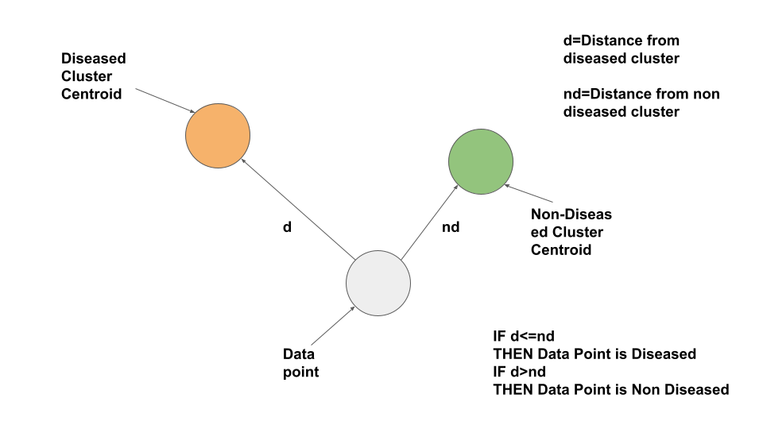
METHODOLOGY BEHIND THE CLASSIFIER
CLASSIFIER

Slide 36
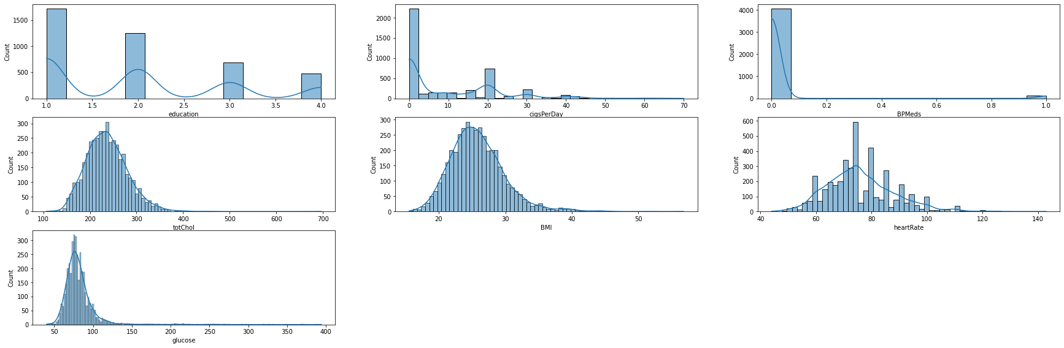
MISSING VALUE FILLING
feature | number of missing values
sex | 0
age | 0
education | 105
currentSmoker | 0
cigsPerDay | 29
BPMeds | 53
prevalentStroke | 0
prevalentHyp | 0
diabetes | 0
totChol | 50
sysBP | 0
diaBP | 0
BMI | 19
heartRate | 1
glucose | 388
TenYearCHD | 0
IMPUTATION METHOD
feature | Central Tendency for filling the missing values
education | MODE
cigsPerDay | MEAN
BPMeds | MODE
totChol | MEDIAN
BMI | MEDIAN
heartRate | MEAN
glucose | MEDIAN

Slide 37
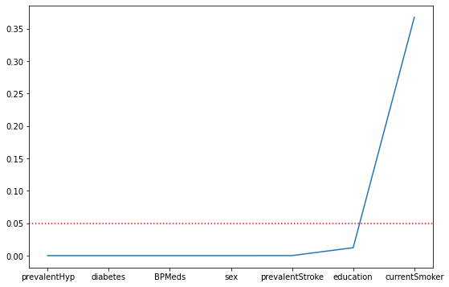
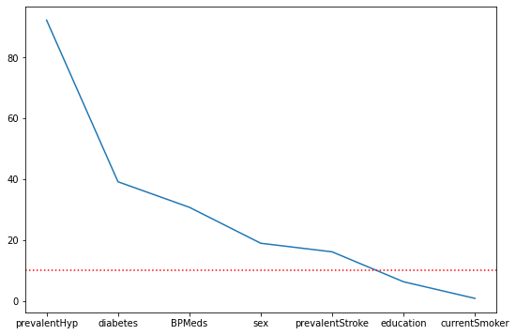
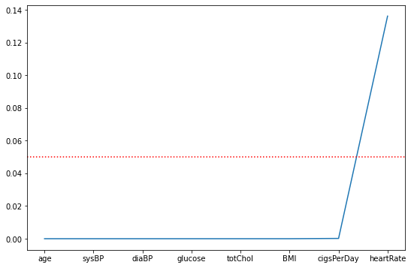
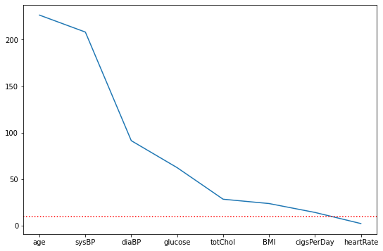
FEATURE SELECTION
ACCORDING TO THE CHI-SQUARE FEATURE SELECTION METHOD “currentSmoker” FEATURE IS THE LEAST IMPORTANT CATEGORICAL FEATURE.
P VALUE
SCORE
ACCORDING TO THE ANOVA FEATURE SELECTION TEST “heartRate” FEATURE IS THE LEAST IMPORTANT NON CATEGORICAL FEATURE.

Slide 38
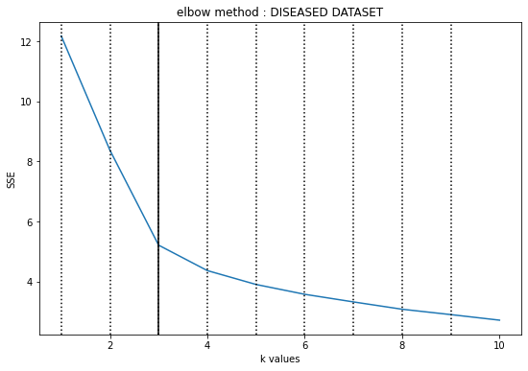
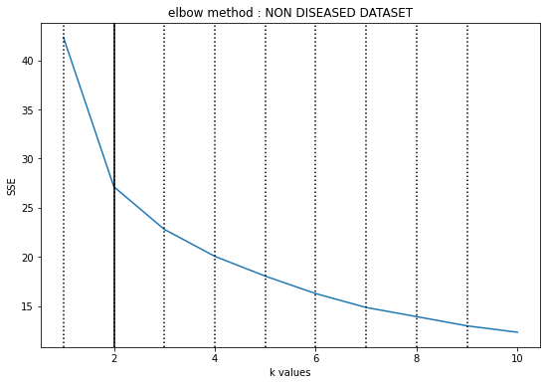
BEST K USING ELBOW METHOD

Slide 39
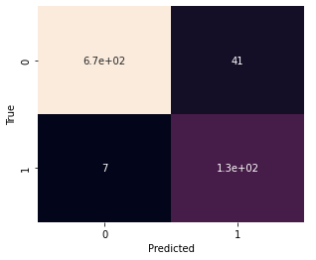
FINAL RESULT
 | PRECISION | RECALL | F1-SCORE | SUPPORT
0 | 0.99 | 0.94 | 0.97 | 712
1 | 0.76 | 0.95 | 0.84 | 136
ACCURACY |  |  | 0.94 | 848
MACRO AVG | 0.87 | 0.95 | 0.90 | 848
WEIGHTED AVG | 0.95 | 0.94 | 0.95 | 848
 | JACCARD SCORE
0 | 0.94
1 | 0.73

Slide 40
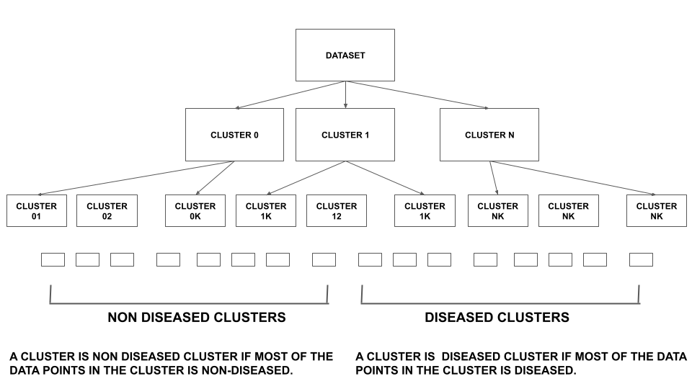
CONCLUSIONS AND FUTURE DEVELOPMENT
By analyzing all the approaches and the results, this is a valuable step to building a tree-like clustering structure for segmenting the data with minimum noise.
Tree-like Clustering means clustering over the clusters in a hierarchical manner.
Using this methodology we can create the K-Means algorithm more powerful. So, we can find more reliable and trustable data segments.
END OF PROPOSED WORK

Slide 41
Thank You

Slide 42
I Conclude The Presentation Here.

